Slide 1
Understanding Career Aspirations of Gen Z
KultureHire Data Analysis Internship
Achuth Akilesh

Slide 2
Project Overview
This project explores Gen-Z’s career aspirations, challenges, and industry trends to help them make informed decisions.
Many Gen-Z individuals struggle with career uncertainty due to rapidly evolving industries, limited mentorship, social pressures, and skill gaps
Research includes surveys and interviews with Gen-Z individuals, career counselors, and industry experts to analyze career trends and job market expectations.
The study focuses on unconventional career paths, soft skills, networking, AI’s impact on jobs, and mental health in career choices.
The project will provide career guidance through reports, awareness campaigns, and interactive sessions like workshops and webinars.

Slide 3
Methodologies used

Slide 4
Step 1 : problem statement documentation

Slide 5
What? – The project addresses the career uncertainties and challenges faced by Gen-Z, including evolving job roles, lack of guidance, and skill mismatches
Why? – Many Gen-Z individuals struggle with career decisions due to limited mentorship, societal expectations, and a rapidly changing job market.
Who? – This problem affects students, early-career professionals, and job seekers within the Gen-Z demographic who need clarity in career choices.
Where? – The issue is prevalent across educational institutions, workplaces, and online career guidance platforms where Gen-Z seeks information
When? – Career uncertainty begins during high school and extends into early professional years when individuals make crucial job-related decisions.
How? – By conducting research through surveys, interviews, and data analysis, the project aims to provide structured career insights, mentorship opportunities, and industry-aligned guidance.

Slide 6
Step 2 : data collection

Slide 7
Data was collected using Google Forms, where structured surveys were designed to gather insights from Gen-Z individuals, including students and early-career professionals.
The survey also included inputs from career counselors, HR professionals, and industry experts to understand job market trends and skill requirements.
Questions focused on career aspirations, challenges in decision-making, access to mentorship, skill gaps, and the influence of societal expectations.
Sample questions included:
What are your top three career choices, and why?
What factors influence your career decisions the most? (Parents, peers, trends, personal interest, etc.)
Do you feel prepared for the current job market? Why or why not?
Have you received any mentorship or career guidance? If yes, how helpful was it?
What skills do you think are essential for your chosen career path?

Slide 8
Step 3: data cleaning and standardisation

Slide 9
Removing Incomplete Responses – Responses with missing or incomplete data were removed to ensure the accuracy and consistency of the dataset.
Standardizing Format – All responses were standardized, such as ensuring consistent formatting for dates, numerical values, and categorical responses to avoid discrepancies.
Handling Outliers – Extreme or irrelevant data points, such as responses that significantly deviated from the norm, were identified and either corrected or excluded.
Categorizing Data – Open-ended responses were categorized into predefined themes or groups to facilitate easier analysis, making sure the data remained meaningful and consistent.

Slide 10
Step 4: data analysis using sql

Slide 11
1. What industries are Gen-Z most interested in pursuing careers in?
SELECT
la.industry_name AS industry,
COUNT(pi.user_id) AS total_users FROM
personalized_info pi JOIN
learning_aspirations la
ON pi.user_id = la.user_id WHERE
YEAR(CURDATE()) - pi.birth_year BETWEEN 9 AND 24 -- Gen-Z age range (adjust if necessary)
GROUP BY
la.industry_name ORDER BY
total_users DESC
LIMIT 5; -- Top 5 industries

Slide 12
2. What are the top factors influencing Gen-Zʼs career choices?
SELECT
factor,
COUNT(*) AS total_users FROM
personalized_info pi JOIN
learning_aspirations la
ON pi.user_id = la.user_id WHERE
YEAR(CURDATE()) - pi.birth_year BETWEEN 9 AND 24 -- Gen-Z age range GROUP BY
factor ORDER BY
total_users DESC
LIMIT 5;

Slide 13
3. What is the desired work environment for Gen-Z? (e.g., remote, hybrid, in- office)
SELECT
work_environment, COUNT(*) AS total_users
FROM
personalized_info pi WHERE
YEAR(CURDATE()) - pi.birth_year BETWEEN 9 AND 24 -- Gen-Z age range GROUP BY
work_environment
ORDER BY
total_users DESC;

Slide 14
4. How do financial goals, such as salary and benefits, impact career aspirations among Gen-Z?
SELECT
financial_goals, COUNT(*) AS total_users
FROM
personalized_info pi JOIN
manager_aspirations ma
ON pi.user_id = ma.user_id WHERE
YEAR(CURDATE()) - pi.birth_year BETWEEN 9 AND 24 -- Gen-Z age range GROUP BY
financial_goals
ORDER BY
total_users DESC;

Slide 15
5. What role do personal values and social impact play in career choices for Gen-Z?
SELECT
factor,
COUNT(*) AS total_users FROM
mission_aspirations ma JOIN
personalized_info pi
ON ma.user_id = pi.user_id WHERE
YEAR(CURDATE()) - pi.birth_year BETWEEN 9 AND 24 -- Gen-Z age range AND
factor IN ('personal_values', 'social_impact') GROUP BY
factor
ORDER BY
total_users DESC;

Slide 16
Step 5: executive dashboard using excel

Slide 17
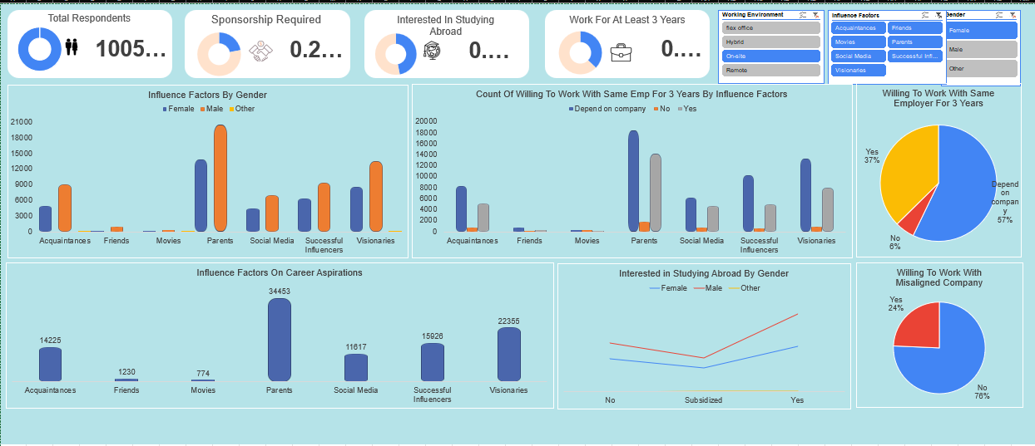

Slide 18
Step 6: executive dashboard using power-bi

Slide 19
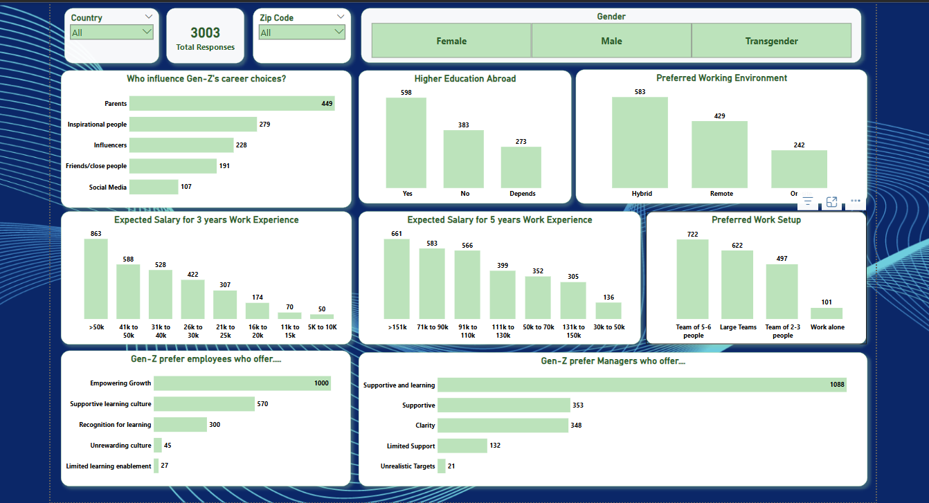

Slide 20
findings and insights

Slide 22
Recommendations
Investing in leadership programs, implementing feedback systems, and holding regular team meetings fosters growth and open communication.
Conducting regular market research, implementing performance-based pay, communicating openly about the company's financial status, and enhancing non-monetary benefits like health insurance, flexible hours, and professional development opportunities can boost employee engagement and satisfaction.
Creating personalized career development plans, providing constructive feedback, establishing clear promotion criteria, encouraging cross-functional projects, and recognizing employee achievements can drive growth, motivation, and job satisfaction.

Slide 23
thank you!

